Slide 1

Graph each equation and identify its key characteristics.
1.
2.
Center: __________ Radius: __________
Center: __________ Radius: __________
3.
4.
Center: ____________ Vertices: _____________________________
Co-Vertices: _____________________________
Foci: _____________________________________
Center: ____________ Vertices: _____________________________
Co-Vertices: _____________________________
Foci: _____________________________________
5.
Center: ________________
Vertices: ______________________________ Co-Vertices: ___________________________ Foci: ___________________________________
Asymptotes: ___________________________ ___________________________

Slide 2

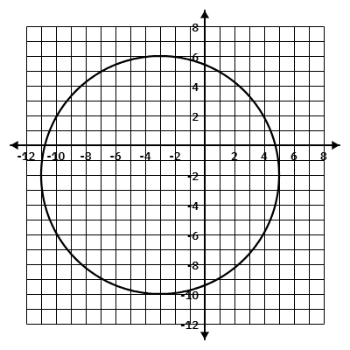
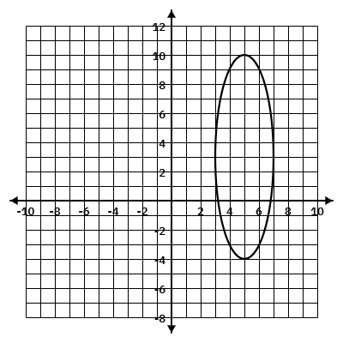
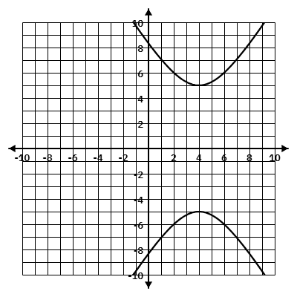
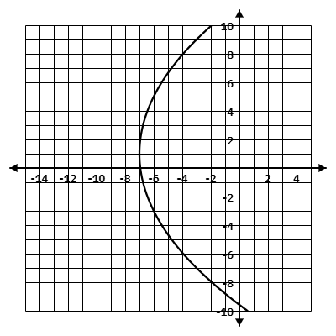
6.
Center: ________________
Vertices: ______________________________ Co-Vertices: ___________________________ Foci: ___________________________________
Asymptotes: ___________________________ ___________________________
7.
8.
Vertex: ________________ Axis of Sym: _____________
Vertex: ________________ Axis of Sym: _____________
Focus: ________________ Directrix: _________________
Focus: ________________ Directrix: _________________
Write the standard form of the equation given the graph.
9.
10.
9. ____________________________________
10. ___________________________________
11.
12.
11. ____________________________________
12. ____________________________________

Slide 3

Write the equation of the circle in standard form with the given information.
13. Center: (1, -4), Point on Circle: (-9, -2)
14. Endpoints of Diameter: (-7, -4) and (3, -8)
Equation: _____________________________________
Equation: _____________________________________
Write the equation of the ellipse in standard form with the given information.
15. Vertices: (-2, -3) and (12, -3) Co-Vertices: (5, -1) and (5, -5)
16. Co-Vertices: (-3, 2) and (-11, 2) Foci: (-7, 5) and (-7, -1)
Equation: _____________________________________
Equation: _____________________________________
Write the equation of the hyperbola in standard form with the given information.
17. Vertices: (4, 6) and (-4, 6) Co-Vertices: (0, -3) and (0, 15)
18. Vertices: (2, -7) and (2, 9) Foci: (2, -9) and (2, 11)
Equation: _____________________________________
Equation: _____________________________________
Write the equation of the parabola in standard form with the given information.
19. Vertex: (-4, 5); Focus: (-7, 5)
20. Focus: (-8, 2); Directrix: y = 0
Equation: _____________________________________
Equation: _____________________________________

Slide 4

Classify each conic and write the equation in standard form.
21.
Circle
Ellipse
Hyperbola
Parabola
22.
Circle
Ellipse
Hyperbola
Parabola
Equation: ______________________________________
Equation: ______________________________________
23.
Circle
Ellipse
Hyperbola
Parabola
24.
Circle
Ellipse
Hyperbola
Parabola
Equation: ______________________________________
Equation: ______________________________________
Solve the system by graphing.
25.
Solution(s):

Slide 5

26.
Solution(s):
Solve the system algebraically.
27.
28.
Solution(s): ___________________________________
Solution(s): ___________________________________
29.
30.
Solution(s): ___________________________________
Solution(s): ___________________________________

